Slide 1
Modelling a Rover Controller using an Arduino

Slide 2
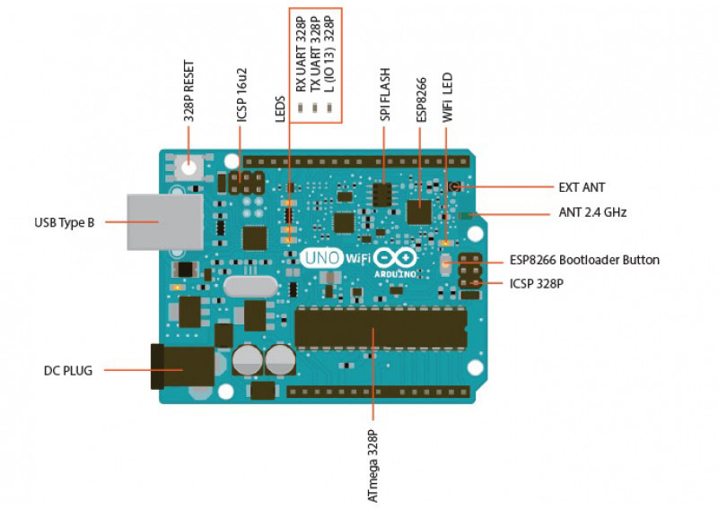
What is an Arduino?
Its like a little, tiny and extremely small device that simplifies the use of microcontrollers
Microcontrollers are a type of integrated circuit (basically an extremely tiny computer)
You can literally do whatever you imagine all the way to infinity and beyond -> except with limits ☺

Slide 3
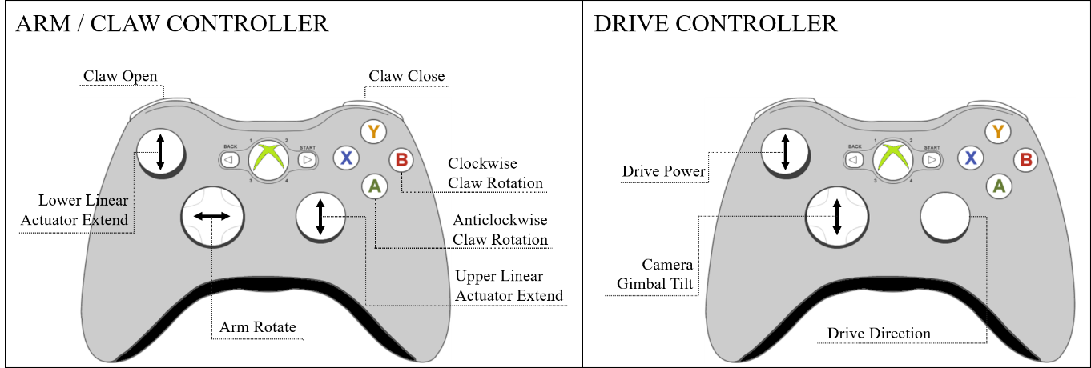
Why?
Currently the Rover uses two xbox controllers.
We want to move to a new system, with more control and only one controller. (Currently in the process of doing so)
This task will give you an introduction to working with software and the basic electrical work we do.
Current System

Slide 4
What you need
A group of 3 - 5
1 Arduino
The USB Cable that fits your Arduino
2 Joysticks (Although if you like a design that uses only 1 that’s fine)
Any other buttons and switches you want for your design.
A laptop with the BLUEsat Development Environment setup on it.
Some jumper cables.

Slide 5
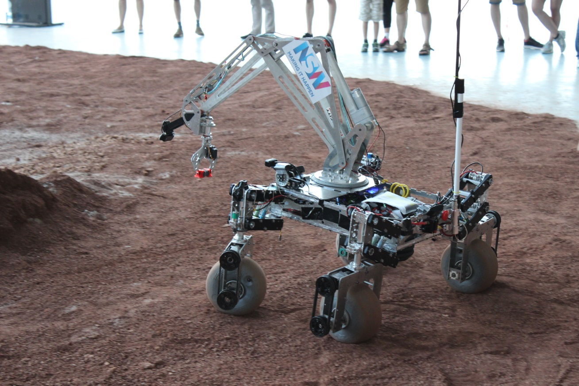
Aim
Build a (simplified) controller for the Rover.
The direction and speed of the Rover will be encoded using LEDs.
We need to control:
Direction, using x and y.
The speed velocity of the Rover.

Slide 6
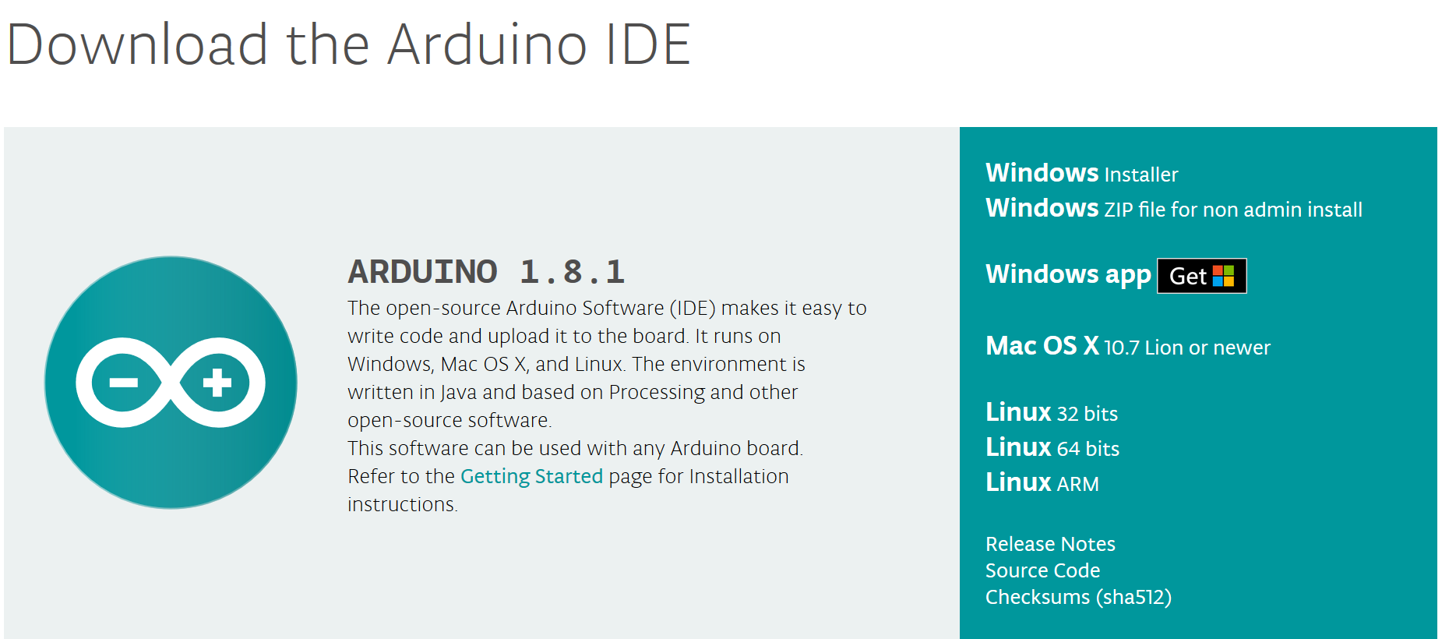
Get Setup
If you missed Raghav’s talk earlier you’ll need to setup our development environment on at least one computer. (There’s sheets with instructions on them)
Go to https://www.arduino.cc/en/Main/Software Download the Arduino IDE.
Download the code from https://raw.githubusercontent.com/bluesat/arduino_joystick/master/2019/arduino_joystick_2019.ino and copy it into a new Arduino file (.ino).

Slide 7
Wiring Demonstration

Slide 8
Code Walkthrough

Slide 9
Lost? Clues on where to start?
Look through the Arduino Resource to see:
How the Joystick and LEDs are connected.
A reference for useful functions.
There are also example codes that go along with these devices so try them out see how they work
Edit the necessary places with your own pieces of code
Go talk to a demonstrator. We will try to get the GUI version of this activity working!
To easy? Want a challenge? Damn, you are goood!

Slide 10
Feedback?
https://goo.gl/forms/CmMiGUyj9s2e6pGP2
Useful Links:
https://bluesat.atlassian.net/wiki

